Slide 1
“Everyone has a story”
Becoming Trauma-Informed in the higher education setting
Richard Ruhrold, PH.D., HSPP
Chief psychologist
Senior Vice President, Clinical Operations
BoweN Center for Human Services, Inc.

Slide 2
Objectives – a.m.
Define trauma as an individualized experience.
Estimate of the prevalence of Adverse Childhood Experiences (ACEs) among both the US population and post-secondary students.
Describe how ACEs impact adult well-being (mental health, substance use, physical health and educational-vocational outcomes).
Describe protective factors that may mitigate the negative of impact of ACEs.

Slide 3
Objectives – p.m.
Describe indicators that a student may be suffering from a trauma-related behavioral health disorder.
Describe characteristics of trauma-informed professionals and institutions.
Identify both individual and institutional strategies for becoming more trauma-informed and the potential benefits of doing so.

Slide 4
In general, trauma can be defined as a psychological, emotional response to an event or experience that is deeply distressing or disturbing.
This trauma definition can refer to something upsetting, such as being involved in an accident, having an illness or injury, losing a loved one or going through a divorce. It can also encompass extreme experiences that can be severely damaging, such as torture or sexual assault.

Slide 5
An event can only be understood as “traumatic” by considering a person’s unique responses to the event, both immediate and delayed.

Slide 8
Traumatic experiences can teach us some compelling “lessons”
The world isn’t safe.
It’s dangerous to trust people.
I am/I can’t ________.

Slide 10
Chronic “flight, fight or freeze” state.

Slide 11
Early life trauma can be especially impactful.
Adverse Childhood Experiences (ACEs)

Slide 12
The Adverse Childhood Experiences (ACE) Study
Principal researchers: Vincent J. Felitti, MD & Robert Adna, MD, MS

Slide 13
Vincent Felitti, MD
Robert Adna, MD, MS

Slide 14
ACE study overview
Longitudinal study sponsored by the CDC.
Arose out of Dr. Felitti’s concerns about high drop out rates among patients at the obesity clinic at the Kaiser Permanente Department of Preventive Medicine (San Diego, CA) where he was chief physician.
Initial data collection – 1995-1997. Original sample followed for 15 years.
Examines social and health impacts of ACEs into adulthood.
Related research has continued through the CDC and other institutions.

Slide 15
ACE study sample demographics
17,421 members of the Kaiser Health Plan in San Diego County.
Approximately equal numbers of men and women.
74.8% white.
11% Latino.
7.5% Asian and Pacific islander.
5 % African-American.
Average age 57.
75.2% had attended college.
40% earned college degrees.
All were employed.
All had access to good health care.

Slide 17
The ACE Study Questionnaire ACE score range 0-10

Slide 18
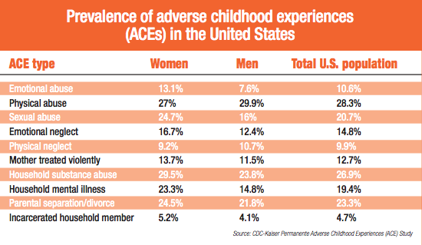

Slide 20
ACEs, mental health and substance use

Slide 21
ACE Scores and Suicide Attempts

Slide 22
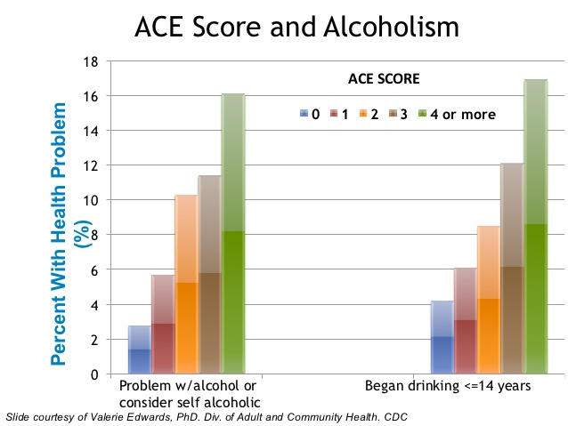
ACE Scores and Alcohol Use Disorder
ACE Scores and Alcohol Use Disorder

Slide 23
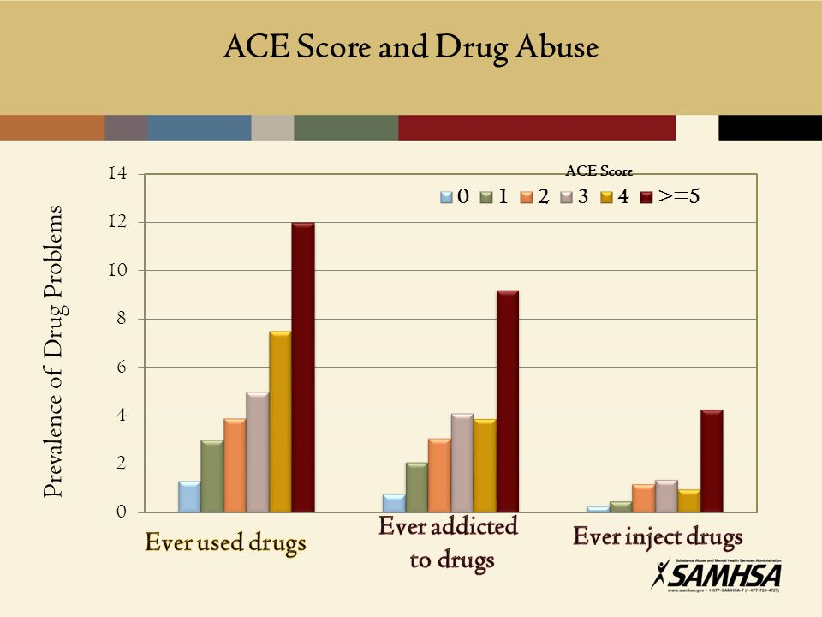
ACE Scores and Drug Use

Slide 24
Vaping?

Slide 25
SUDs and ACEs What percentage of women & men suffering from a substance use disorder have a history of multiple types childhood trauma?
75+%

Slide 26
SUDs and ACEs
These findings align with our growing understanding of the nature of addiction.

Slide 27
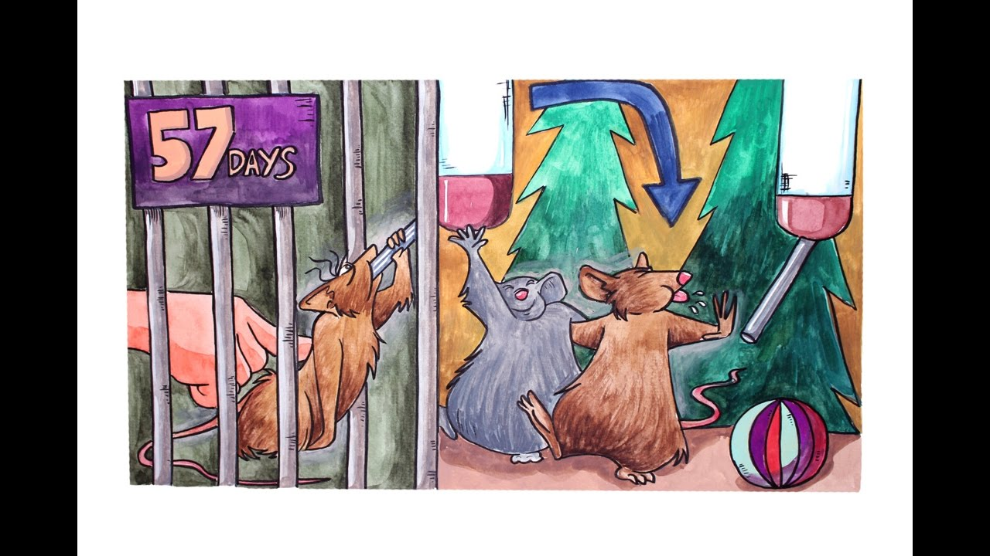
Venniro, et al. (2018). Volitional social interaction prevents drug addiction in rat models. Nature Neuroscience, 21, 1520–1529.

Slide 28
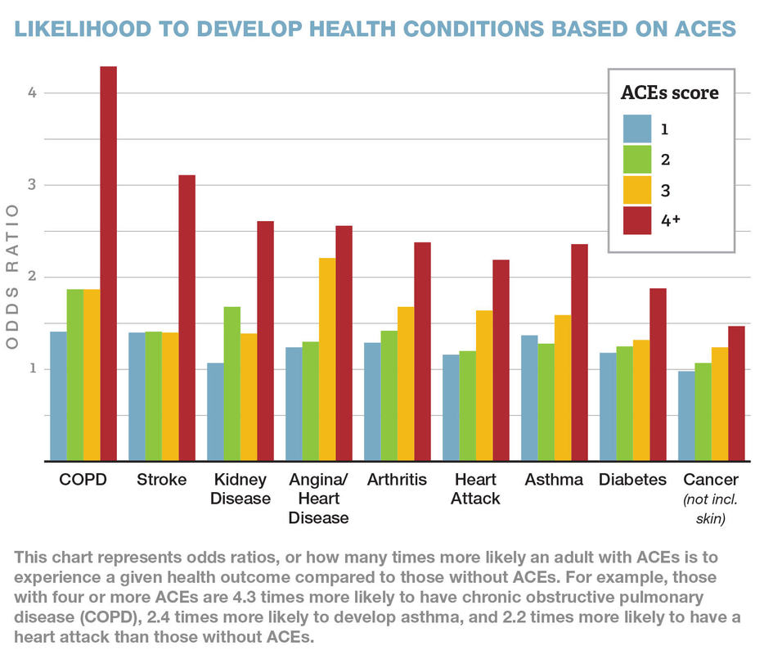
Physical health outcomes

Slide 29
People with ACE scores of 6+ have been found to have an average life expectancy that is 20 years lower than that of the general US population.

Slide 30
“The majority of mental health and substance abuse problems are due to adverse childhood experiences.” “Adverse childhood experiences are the most critical public health issue in America.” - Robert F. Anda, MD, MS. (Indianapolis, October 2016)

Slide 31
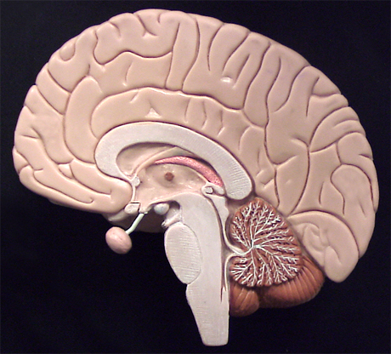
“Bottom up” development
Cerebral cortex
Midbrain
Brain stem

Slide 32
1,000,000+ Synapses per second
Source: Harvard University Center for the Developing Child (2017)

Slide 33
Neural density across time
At birth
5 years old
Politician
Courtesy Nancy Swagonski, MD, Riley Children’s Hospital
Notes:
33

Slide 34
“Toxic stress”
Early cortical development is heavily influenced by our experiences.
Chronically elevated levels of stress hormones (cortisol and adrenaline) can adversely impact early brain growth and organization.
“Toxic stress” has also been linked to weakened immune system function and possible genetic alterations.

Slide 35
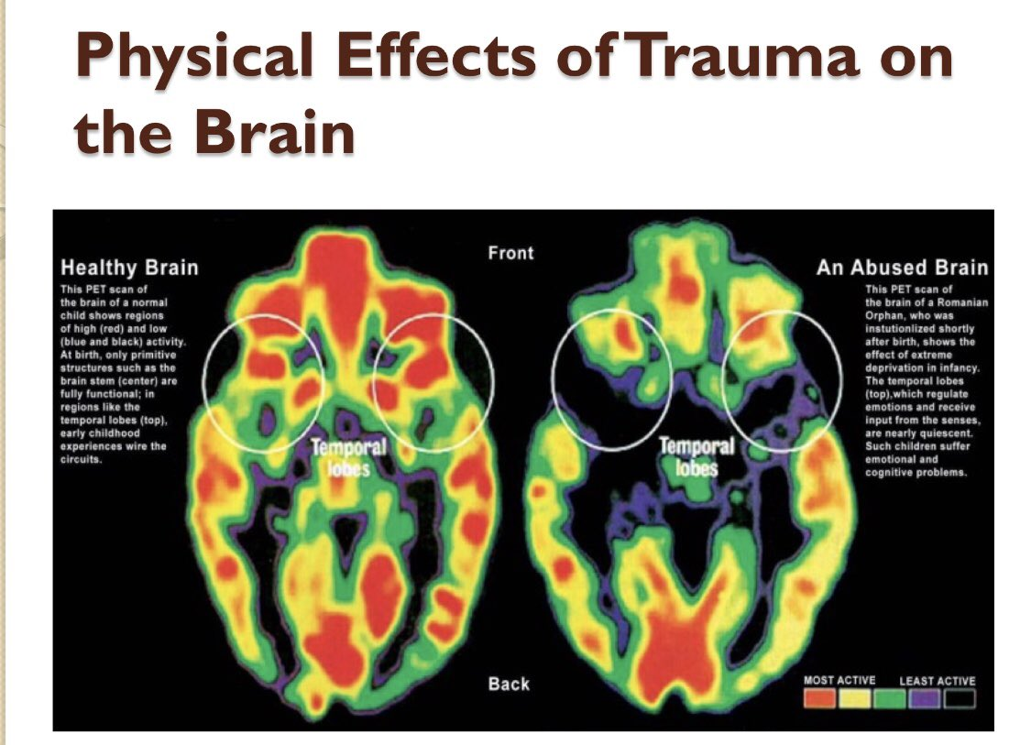

Slide 36
Those with elevated ACE scores are more likely to struggle with….
Learning and memory
Emotional regulation*
Social and relationships (attachment)
*See Cloitre, M, et al. (2019). Emotional regulation mediates the relationship between ACEs and physical and mental health. Psychological Trauma: Theory, Research, Practice and Policy, 11, 82-89

Slide 37
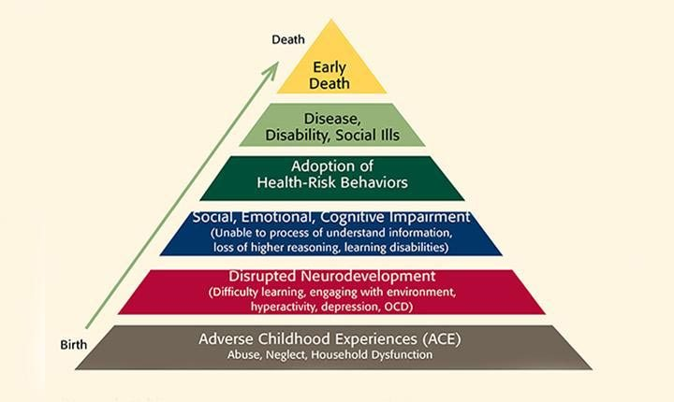
The ACEs Pyramid

Slide 38
The negative impact of adverse childhood experiences (ACEs) can be lifelong…unless people like us do something about it!

Slide 39
There’s more to the story…
Resiliency and protective factors

Slide 40
Some factors that may mitigate the negative impact of ACEs
Genetic factors
Higher IQ
Individual temperament (attachment style?)
Spirituality - Sense of purpose/mission

Slide 41
Some factors that may mitigate the negative impact of ACEs
Dependable and stable relationships
Healthy coping skills and wellness practices
Good physical health
Economic stability
Oxytocin as buffering agent?

Slide 42
“Everyone has a story” Recap of this morning’s conversation
Defined trauma as an individualized experience. Trauma as a “teacher”.
Defined Adverse Childhood Experiences (ACEs) and described the CDC’s ongoing “ACE Study”.
ACE Scores: Range from 0-10 and indicate the number of ACEs an individual experienced between birth and age 18.
Described key findings of the ACE study and the relationship of “ACE Scores” to poor health outcomes (mental health, SU, physical health).
Described “toxic stress” and the mechanisms by which ACEs can negatively impact health outcomes.
Described protective factors that can limit negative impact.

Slide 43
“The majority of mental health and substance abuse problems are due to adverse childhood experiences.” “Adverse childhood experiences are the most critical public health issue in America.” - Robert F. Anda, MD, MS. (Indianapolis, October 2016)

Slide 44
Behavioral health and Adverse Childhood Experiences (ACEs) in post-secondary education

Slide 45
(October 2018)

Slide 46
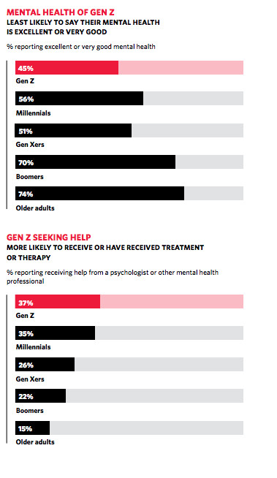

Slide 47
“One in three first year college students worldwide report a mental health disorder.”
Source: American Psychological Association (APA) News release, September 13, 2018

Slide 48
“One in three Ph.D. students is at risk of a common psychiatric disorder.”
Source: Science Direct, February 2017.

Slide 49
A study published in 2015 (G. Panger) concluded that “depression afflicts almost half of STEM graduate students at UC Berkeley”.

Slide 50
ACEs among college students
ACE scores: US population estimates

Slide 51
Trauma and post-secondary academic achievement
Coping with the stress of the college environment is more difficult for students with a history of trauma - Read, et al. (2011)
Trauma-exposed African-American female students are more likely to leave college before the end of their second year. (Boraz, et al., 2013)
Neuroscientists Schaefer & Nooner (2017) discovered differences in fundamental brain function among college students with co-occurring trauma and depression symptoms.

Slide 52
This is not a case of “us vs. them”.

Slide 53
The ACE Study Questionnaire

Slide 54
Menti.com 29 08 09

Slide 56
Little data about MH among post-secondary educators There’s a lot of data about “professional burnout”.
Groups identified at highest burnout risk…
Nurses
Physicians
Behavioral health professionals
Social services workers (e.g. child protective services)
Educators

Slide 57
Considering “stress and burnout” Some commonly cited characteristics
Changes in sleep habits (e.g. insomnia).
Physical changes such as headaches, changes in appetite or weight. Increased susceptibility to illness.
Reduced energy, motivation and enthusiasm.
Increased forgetfulness. Reduced concentration and attention.
Increased emotionality (nervousness, sadness, irritability, anger, guilt, etc.).

Slide 58
What can we do?
Characteristics of trauma-informed professionals and institutions

Slide 59
Awareness of possible trauma indicators among students (“Flight, fight or freeze”)
Difficulty focusing, attending, retaining and recalling. (Maybe it’s not “ADD”.)
Tendency to miss a lot of classes.
Challenges with emotional regulation.
Elevated startle response.

Slide 60
Awareness of possible trauma indicators among post-secondary students
Fear of taking risks.
Elevated anxiety about deadlines, exams, group work or speaking in front of the class.
Withdrawal and isolation.
Involvement in unhealthy relationships.

Slide 61
What can we do? Building protective factors – Helping people feels safer
Include trauma education in student orientation.
Staff trauma education (including campus safety and health staff).
Facilitate open conversations.
Challenge stigma & normalize shared struggles.
Ease access to care and support.

Slide 62
What can we do? The Institutional level – Helping people feel safer
“Brain breaks” during classes.
Create accessible “safe spaces” on campus.
Trauma-focused walk-throughs
Consider on-campus research?

Slide 63
Outreach to high risk groups. These include, but are not limited to…
Military veterans
LGBTQ+ students
Students with foster care history
Students on the autism spectrum
Refugee students
Non-traditional adult learners
Source: Trauma-informed practices in post-secondary education, Shannon Davidson, Ph.D., Education Northwest

Slide 64
What’s the benefit? At the HS level, institutions that commit to creating a trauma-informed culture see…
More consistent class attendance.
Improved academic achievement and test scores.
Improved student retention and higher graduation rates.
Improved faculty retention.

Slide 65
We may need to think and talk a bit differently.

Slide 66
What’s my first question?
“What’s wrong with her?”
“What’s happened to her?”

Slide 67
“What’s his problem?”
“What’s his story?”

Slide 68
“Hurting” “Wounded”
“Obnoxious”
“Manipulative”
“Lazy”
“Unmotivated”
“Just wants attention.”
“Immature”
“Not college material”

Slide 69
Resources for further conversation

Slide 70
https://www.youtube.com/watch?v=KdDr_nZOIXc

Slide 72
Some “take home” points
Trauma is widespread (It’s not “us and them”).
While trauma is an individualized experience, it does “teach” some universal “truths”.
“Toxic Stress”: Early trauma (Adverse Childhood Experiences) can have substantial impact upon later life-functioning, health, quality of life and life expectancy.
Consider encouraging trauma-informed thinking and practices at both the individual and institutional levels through education and other initiatives.
Keep in mind, “There’s always a story” (person vs. situation).
Never (ever) underestimate the potential impact of even
one compassionate outreach to someone in distress.

